Slide 1

Exploratory Data Analysis
G2M insight for Cab Investment firm
03/20/2023

Slide 2

Agenda
Executive Summary
Problem Statement
Approach
EDA
EDA Summary
Recommendations

Slide 3
Executive Summary
We have to analyze two companies, Pink Cab and Yellow Cab, to find out the better performing company to invest in.
We have data about the cities, customers, cabs and transactions.
Leveraging this data can help us answer the questions.

Slide 4
Problem Statement
To determine the better investment option, few questions are posed and tried to be answered by analyzing the data that we have:
How much profit has each company generated in all the years of the data?
How many customers have used the service of each company across US in years spanning the data?
Is there a difference in profit margin based on user base of each company?

Slide 5
Approach
To answer the first question, we must calculate the profit for each ride and get the total profit for all the years for each company.
The second question can be analyzed by counting the number of transactions made for ride by each company every year.
The third question requires us to calculate the profit margin and number of customers for each company for each month of all the years.
All the findings are visually displayed in the next slide

Slide 6
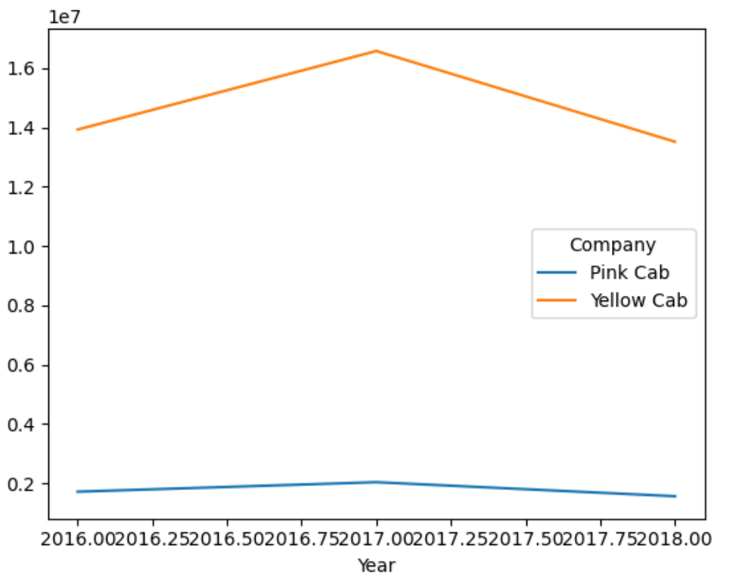
EDA
Here we see that Yellow Cab is generating more profit than Pink Cab for all the years. This profit is substantial.

Slide 7
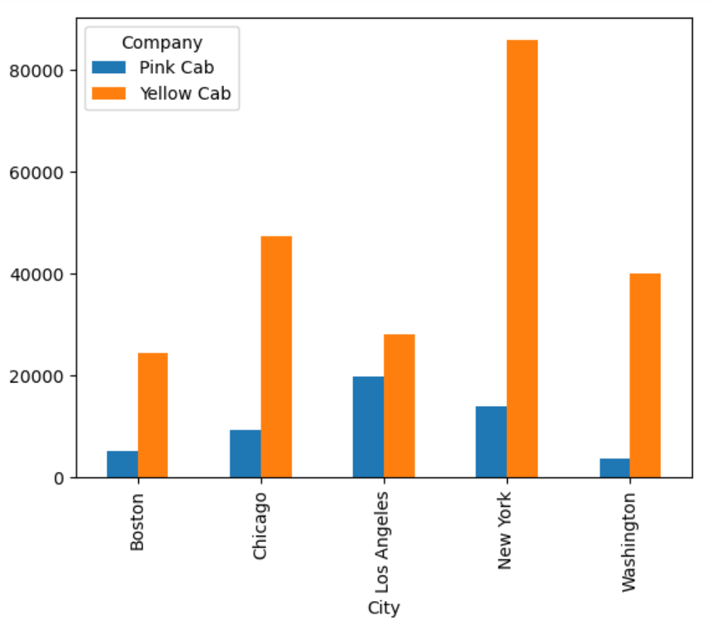
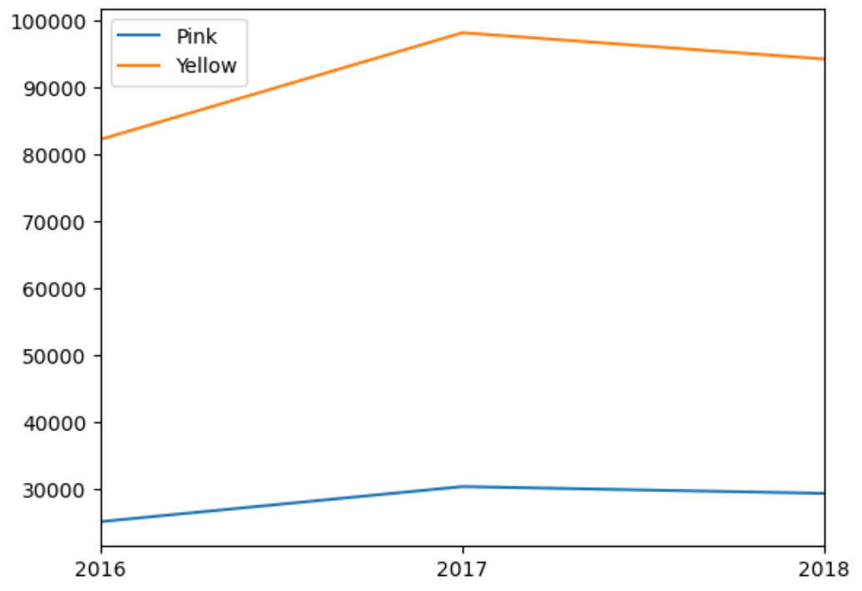
EDA
Also, the number of users for Yellow Cab is significantly more than the Pink Cab. Not only this but also the number of users in the top five cities with highest transactions is also greater for Yellow Cab.

Slide 8
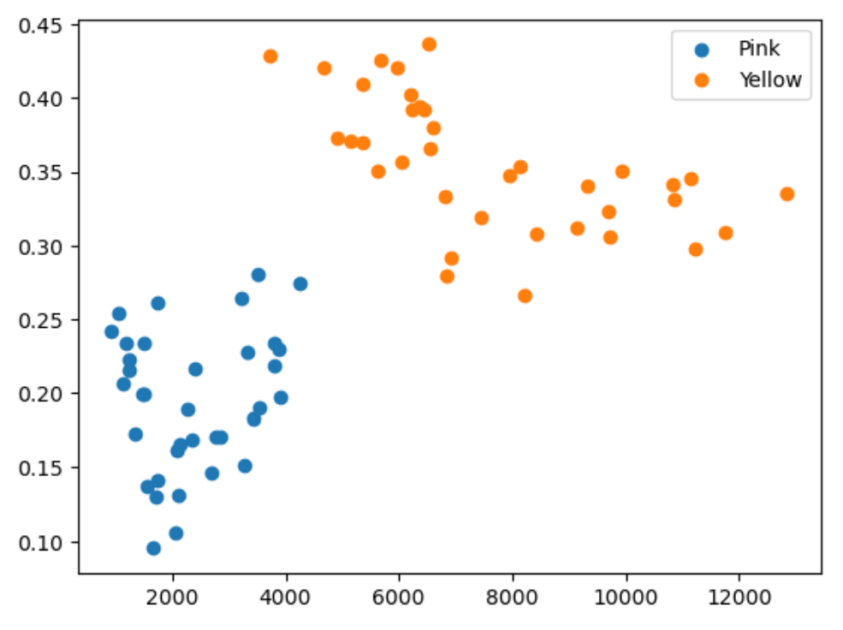
EDA
Yellow cab which has more users also has higher profit margins.

Slide 9
EDA Summary
The analysis shows that Yellow Cab can be a profitable investment.
There are major cities like San Francisco whose markets are open to be captured and Yellow Cabs owing to its profitable nature can do that easily.
Higher customer turnover will also result in higher profit margins al is shown by the visualizations.
This will make the investment furthermore appealing.

Slide 10
Mandar Parkar
Thank You

Slide 11
Rectifications
There are certainly deficiencies in the visualizations and the analysis could also have been better.
But I have completed this task in a short time (2 days) since I had my assignments and extracurricular work.
Thank you for your consideration.

